Slide 1
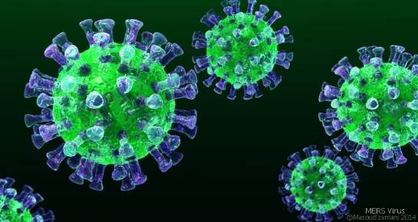
My dear diary
Marianna Pia Bove IIB

Slide 2
At the time of the coronavirus…
Hello my dear diary,
how are you? I think you are fine, but I’m very very sad…because I miss everyone. It’s impossible to stop time, the days pass quickly! I live in an area with the garden, but I miss going out with my friends. Today I will tell you about my usual and boring day in quarantine. In the morning, I usually getting up at eight o’clock, I’m breakfast with milk and my favourite cereals. After breakfast I’m doing distance learning lessons with my prof.s and my friends. With it we can learn. Then I’m doing my homerwork. At half past one I have lunch with my parents and my brother.

Slide 3
I spend my time at home with them. Ah, I forgot… I spend my time with my dog too! Its name is Asia. In the afternoon I relax reading a book or on the sofa. I do my homerwork and I go to garden to play with my dog. Before dinner I help my mum. In the evening I have dinner. Finally I watch Tv. In this time I’m watching many programs on television. At midnight or later, I go to bed very tired. But there are some things I miss doing before the quarantine. Before the quarantine I used to go to school, but now, I’m spending my time at home with my family; I used to meet my friends but now I’m staying at home; I used to eat pizza with my bff but now I can only call her; I used to do shopping with my mum, my friends; I used to have fun; I used to visit my grandmother; I didn’t use to make cake; I didn’t use to cook.

Slide 4
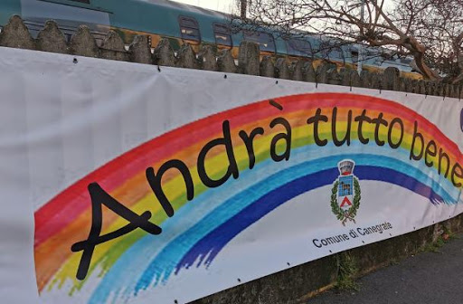
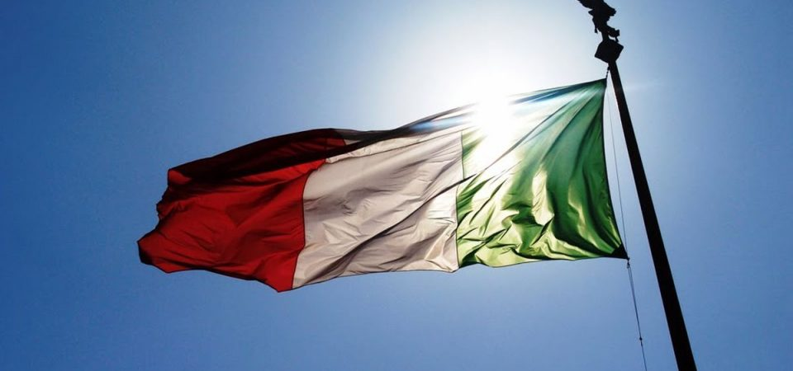
These emotions are very sad, but I love spending more time at home with my family,which I didn’t do before. Dear diary sometimes I worder why all this has happened, but I think we can do it! Today the situation is very serious , these days I feel very sad, alone,angry.
I learned that it takes very little to be happy.
Everything will be fine!!!

