Slide 1
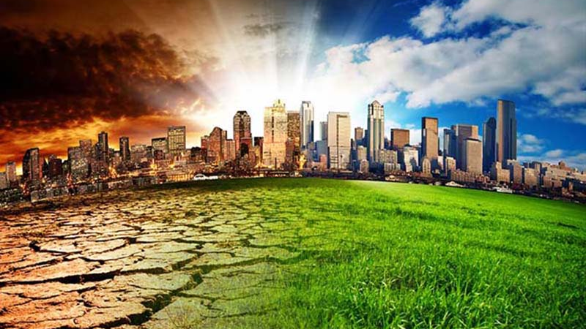
Climate changing

Slide 2
Introduction
Man is rapidly destroying the environment and the animals who live there, for example:
In Malaysia and Indonesia he destroys a lot of rainforest areas and he replaces trees with oil palm that produces palm oil used in food, cosmetics, detergents and biofuels and this decreases biodiersity
He is catching millions of animals to sells them as food, tourist souvenirs, pets, traditional medicine and leather. And for this a lot of animals as pangolins are at risk of extinition
In Artic the ice is melting more quickly because climate changing and this is leaving polar bears homeless

Slide 3
Climate changing
One of the problem of the pollution caused by the man is the climate changing
The climate is foundamental in our lives and the way we work, dress and eat depends on it
But the climate is changing and is becoming hotter and this thing is causing a rainfall precipitations patterns, lack of rain, drough, desertification and flooding that in the next years will became the new climate.

Slide 4
Causes of climate changing
Holes in the ozone layer
The ozone layer is a layer that blocks the sun’s ultraviolet rays but chimical reactions that come from substances such as CFCs used in the past by the man now are causing chimical reactions that are depleting the ozone layer.
This caused two big holes in the ozone layer one big hole above the Artic and an even bigger above the Antartic that won’t decrease before 2045

Slide 5
Greenhouse gas emission
The other cause of the climate changing is the greenhouse gas emission of CO2.
The CO2 is releasing in the atmosphere by the man trhough fossil fuels as carbon,oil and natural gas used for: make electric energy, transport and industries.

Slide 6
Consequences
Climate canging are causing and will cause two types of consequences.
Environmental consequences with an increase of extreme weather conditions as:
Changing of rainfall precipitations patterns
There will be more hurricanes and tornadoes
Lack of rain that will cause drought and desertification all over the world
Melting of sea ice and glaciers
More flooding
And this may have serious consequences four us, and our planet

Slide 7
But they will be also economic and social consequences enfact the new normal climate have all over the world serious consequences as:
Spread of disease
Destruction of homes
Reduced food production and higher food prices
Problems with water resources
And for all of this problems new wars

Slide 8
What we can do
There are many things that we can do to save the planet:
Eat less meat and food zero kilometer
Don’t use the plastic when it is possible
Use less car and more public transport or the bike or if it is possible walk
Plant trees
Turn off the water when we don’t use it
Turn off the lights when we leave the room
Have quick showers
And many other things

Slide 9
Earth Day
The Earth Day is a day where United Nations and other 193 nations celebre the environment and its preservation. This day is celebrited on 22nd of April when in this day in 1970 ,20 million of people partecipated in a day of action and protest to save the planet because they were worried about its future.
Nowadays thousands of people all over the world particularry students celebrate Earth Day proposing to do something to save the world

Slide 10
What I think about climate changing
I think that climate changing is the most important problem nowadays because in my opinion we can fight for all problems of our days but if we don’t fight to climate changing in future we will all be extinct with all form of life.
For this in my opinion we must act now also in our small way, help the planet and get others to do it because only with everyone’s help we will save the planet and our life but if we continue to be careless towards the environment we will pay the consequences

Slide 11
When the last tree has been felled, the last river poisoned, the last fish caught, the last free animal killed, you will find that you can not eat the money
Standing bear-Sioux

